Slide 1

Evidentiary strength of a rare haplotype match:
What is the right number?
Charles Brenner, PhD
DNA·VIEW and UC Berkeley Public Health
www.dna-view.com c@dna-view.com
Brenner CH (2010) Fundamental problem of forensic mathematics – The evidential value of a rare haplotype
Forensic Sci. Int. Genet. doi:10.1016/j.fsigen.2009.10.013

Slide 2
The rules of genetics are simple. Their consequences are not always obvious.

Slide 3
Understanding Y haplotypes
  Evolutionary history and population genetics
  Evidential value

Slide 4
All men are related
All men alive today have a common Y-chromosome ancestor
(probably 3,000 generations ago)

Slide 5
Identity by descent or by state?
Two men have the same Yfiler haplotype.
Connected to a common ancestor without mutation (IBD), or not?
(Terminology:
  IBD = Identity by descent = related with no intervening mutations
  IBS = Identity by state = same haplotype maybe coincidentally)

Slide 6
Y-haplotype lineage
mutation
“Adam”
Convergent mutation (rare)
“Time’s winged chariot”
Same color = same Y-haplotype

Slide 7
Convergent Y mutation
Y haplotype = 17 numbers = position in 17-space
Mutation is random walk in 17 dimensions
  Each step is +1 or -1 in some dimension.
  2 × 17 =34
Random walks rarely return to start.
  2 mutation separation: 1/34 chance that 2nd mutation reverses 1st one.
  Probability to converge otherwise is negligible.
Identical Y-filer haplotype => relationship to common ancestor without mutations (IBD)

Slide 8
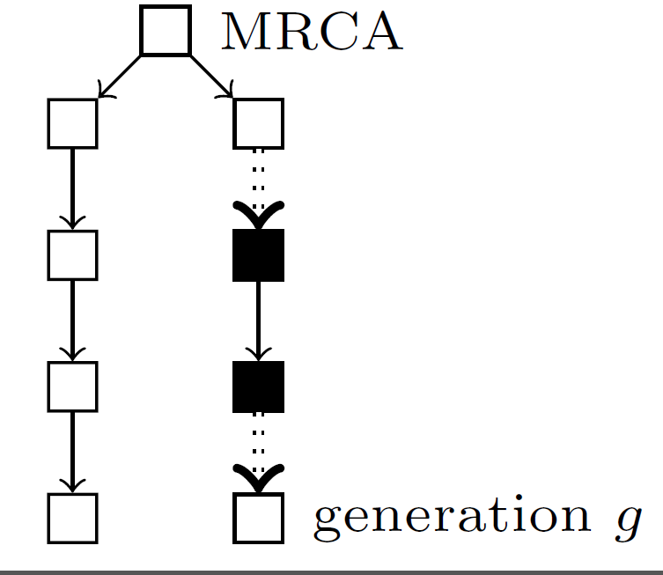
Convergence

Slide 9
Convergence experiment
Simulated Y-filer population (N=90000)
Small proportion of pair-wise matches
  Pr(match)= 1/9000
Given match (IBS), are all IBD?
  Pr(IBD | IBS) = 33/34 (experimental, from simulation)
  Close to computed estimate of non-convergence (previous slide).
    (Why? They are not the same experiment.)

Slide 10
Time to diverge
μ ≈ 1/350 per locus per generation (1/150-1/3000)
μ ≈ 5% per generation (17 loci)
Suppose 4 generations / century
  Common ancestor century ago = 3rd cousins
  8 meioses per century of separation between two contemporary men
Pr( Y’s equal after 1 century) = 70%
Expected # differences = 4/millenium.

Slide 11
Y-haplotype divergence
32
16
8
Expected # differences
4
2
1
virtual non overlap of races

Slide 12
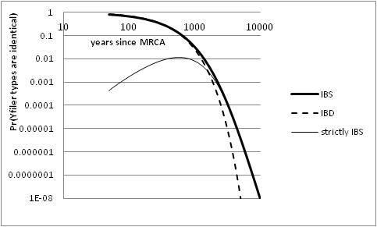
No African-European convergence

Slide 13
Familial Y searching
Suspect who matches Y type is exonerated (maybe it was a population trawl).
So it’s his brother?

Slide 14
Comments on crime-suspect match
If suspect not donor, then
    97% that suspect and donor are IBD
    which is very unlikely if they are separated by more than a few centuries.
A 17-locus haplotype is typically represented by a small number* of men descended without mutation from a common ancestor 100-200 years ago.
Probably way beyond immediate family.
* 1/10000 of the population

Slide 15
probability two random men match?
Example: 1272 Caucasian men (ABI)
  808000 pairwise comparisons (big sample!)
    90% of 1272 men are singletons (no pairwise matches)
    49 pairs of matching haplotypes (49 matches)
    5 triples (5×3=15 pairwise matches)
  … in total 91 pairwise matches / 808000
  Pairwise matching rate 1/8900
Can evidential strength (new type) be less than that? (no matter what the “upper confidence” limit may be)

Slide 16
Y-STR efficacy
random match probability ≈ 1/10000
eliminates all false leads (e.g. familial searching)
Black | 1/14000
Asian | 1/4100
Caucasian | 1/8900
Y-haplotype matching odds for US populations
(17 Yfiler STR loci)

Slide 17
Probability of a new Y haplotype
Assume Y-filer (17 STR loci)
Probability in an actual database?
  Example: 1272 Caucasian men (ABI sample)
    90% are “singletons”
Smaller database
  If n=1, 100% singletons
Suppose we collect the entire world male population. What % of singletons?

Slide 18
Growth of a (Y-)haplotype “database” (population sample)
Kappa = proportion of singletons

Slide 19
Y-filer population sample data
size=# of chromosomes
α=# of singletons (types not repeated)
κ= α/size, proportion of sample that is singleton
 | Size | α | κ=α/n | 1/(1−κ) (“inflation factor”)
US Black | 985 | 925 | 0.94 | 16.4
Asian | 330 | 312 | 0.95 | 18.3
Caucasian | 1276 | 1152 | 0.90 | 10.3
Example D | n−1 | α | 0.9 | 10

Slide 20
Quiz: Probability of new type?
Assume the Example Y-haplotype database.
κ=90% of the chromosomes are singletons.
  Assume κ changes only slowly as D grows.
What is the probability that the next person sampled has a NEW type?
Answer: κ (90%), the same as the probability the last one added was new.
H. Robbins, Ann Math Stat 1968
Corollary: κ of the population is not represented in the database.
Corollary: 1- κ (e.g. 10%) = probability new observation (i.e. crime scene type) IS represented in the database.

Slide 21

Crime occurs!
Y-haplotype obtained
Interesting case:
  donor=criminal
  Crime scene type S not found in database D
Assume database D representative of “suspect population”

Slide 22

Suspect matches crime scene haplotype. Relevant number?
Relevant number is the matching probability, the probability that an innocent suspect would match the crime scene type
given available data of
crime scene type & population database
and general scientific knowledge.
Innocent suspect is the test.
Probability is the issue.
Data means information that we have.
Is there another kind?

Slide 23
Suspect matches crime scene haplotype. Relevant number?
Relevant number is the matching probability, the probability that an innocent suspect would match the crime scene type
given available data of
crime scene type & population database
and general scientific knowledge.

Slide 24
SWGDAM “Statistical Interpretation”
Assumes that issue is to “estimate frequency”
  Unlike probability, refers to unknown information
“Confidence interval corrects for sampling variation.” (For “unobserved” haplotype, amounts to 3/N.)
  Purely statistical idea, ignores scientific knowledge, ignores crime scene occurrence.
Summary: Confuses frequency for probability, and doesn’t even get frequency right.

Slide 25
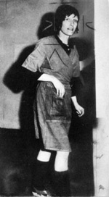
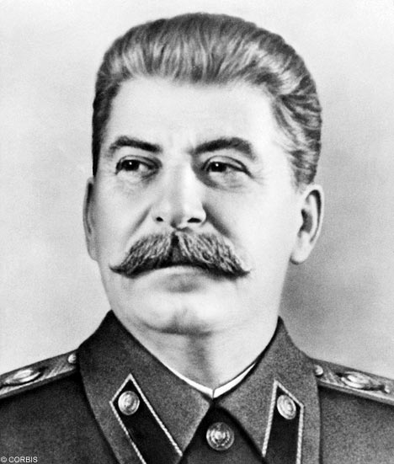

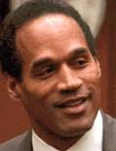
Relevant question: Pr(match)
What is the matching probability
  that a random innocent suspect will match the crime scene DNA type S?
  given that the type was observed at the crime scene,
  given the available population database D, which doesn’t have S. Let the size of D be n−1.

Slide 26
Probability comments
Probability (of a match)
  is a summary of information we have
  Does not involve unknown information.
information we have:
  Population sample
  Crime stain
    Relevant: observations at crime, in population sample
    Irrelevant: it’s name S
Good: Pr(random match| data about S)
Bad: Pr(random match | name of S)

Slide 27
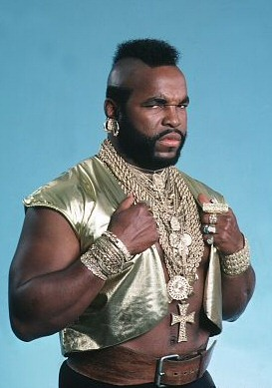
Pr(match) – analysis
Construct the ExtendedDatabase of size n by including the crime stain S (condition on S).
  ExtendedDatabase has α ≈ κn singletons:
  S=S₀, S₁, S₂, S₃, …, S_{α-1}
Innocent suspect arrested, with haplotype T.
We want Pr(match) = Pr(T=S).
  Same as Pr(T=S_{i}) for any i. (Same information/evidence, so same probability)
    Same unrelatedness to innocent suspect.
Obtain in 3 steps.

Slide 28
Pr(match) – 3 part calculation
Assume T is type of innocent suspect
A | T is in ExtendedDatabase | Pr(A)=1−κ
B | T=S_{i} for some singleton S_{i} in the ExtendedDatabase | Pr(B|A)≤κ
C | T=S (=S₀ ) | Pr(C|B&A)=1/nκ
1/n
Pr(C) =Pr(C&B&A)
=Pr(C|B&A)·Pr(B|A)·Pr(A) ≤ (1−κ)/n.

Slide 29
So … Pr(T=S) ≈ (1−κ)/n
Imagine κ=90%. Then Pr(T=S) ≈ 1/10n.
LR = 1/Pr(T=S) ≈ 10n is the odds against a random match, the strength of evidence against a matching suspect.
1/(1−κ) – equal to 10 in this example – is the inflation factor, the factor by which the matching LR exceeds the simple counting rule estimate.

Slide 30
Review – wrong question
ask statistician:
  “some event seen 0/1000. Frequency?”
    “some event” ignores the science
    “0/” ignores the crime scene
    “frequency” presupposes the wrong question
statistical answer: “less than 3/1000”
garbage in, garbage out

Slide 31
Summary
LR= 1/Pr(T=S)
≈ n/(1−κ)
  Test is the innocent suspect
    probability that an innocent suspect would match the crime scene type
  Probability is not frequency
    (inference from data; no confidence intervals)
  Condition on the crime scene type
    (toss into database. No more “0 count”.)
  Sample frequency may not approximate probability
    LR can be >> sample size

Slide 32
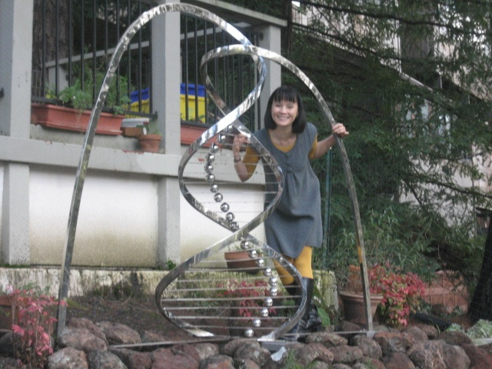
The end
(our new garden sculpture)

