Slide 1
Evidentiary strength of a rare haplotype match:
What is the right number?
Charles Brenner, PhD
DNA·VIEW and UC Berkeley Public Health
www.dna-view.com cbrenner@berkeley.edu
[FP] Brenner CH (2010) Fundamental problem of forensic mathematics – The evidential value of a rare haplotype
Forensic Sci. Int. Genet. 4 281–291

Slide 2
The problem
∃ crime scene Y-haplotype. Call it S.
Imagine a suspect matches. How strong is the evidence that he is the donor?
  In particular, suppose S is previously unobserved in the reference database.
  When we lose our familiar crutch of sample frequency as an estimator for population frequency, what can we use instead?

Slide 3
Mathematical formulation of “Evidential value of a match”
Where do we start?
  B Weir: Likelihood Ratio
  Simplest problem first
LR= ¹/Pr(match crime scene Y haplotype S | random suspect)
Problem is then to evaluate the denominator probability
  Think prospectively: Given the crime scene type S, how surprised will I be if a random (i.e. innocent) man matches?

Slide 4

Suspect matches crime scene haplotype. Relevant number?
Relevant number is the matching probability, the probability that a random suspect would match the crime scene type
given available data of
crime scene type & population database
and general scientific knowledge.
Innocent suspect is the test.
Probability is the issue.
Data means information that we have.
Is there another kind?

Slide 5
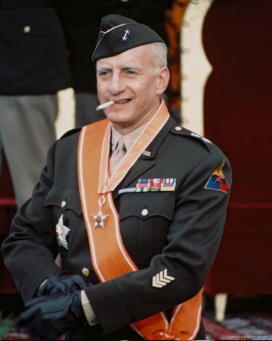
General scientific knowledge
Some version (simplified/selective) of “scientific knowledge” constitutes a model of reality.
Matching probability can be derived given, and only given, an adequate model.
  Model must be valid (close enough to reality)
Models I have considered include:
  (1998) “Infinite alleles” → β prior (Ewens `72).
    Couldn’t validate satisfactorily.
  (1998) Ω^{t} (many equally rare alleles)
    Couldn’t be sure it’s not anti-conservative.
  (2008 & today) “Equal over-representation”
    κ method

Slide 6
General scientific knowledge
Kappa = proportion of singletons
κ=0.9
Growth of a (Y-)haplotype “database” (population sample)

Slide 7
Y-STR efficacy
random match probability ≈ 1/10000. (N≈1000)
eliminates all false leads (e.g. familial searching)
US Caucasian | 1/8900
US Black | 1/14000
US Asian | 1/4100
Y-haplotype matching odds for US populations (Yfiler)
Note: If n<5000, a “confidence interval”, e.g. 1.65/n proponent, is in the absurd position suggesting that the matching probability to a new type is significantly less than the above.
Note: If n<5000, a “confidence interval”, e.g. 1.65/n proponent, is in the absurd position suggesting that the matching probability to a new type is significantly less than the above.
  The empirical match probability from the database per above is practically the whole story.
  If sample frequency of S is unknown (someone lost the database), it is the whole story.
  If S is a new type, can refine them down a little. ☜
  Otherwise (infrequent occurrence), match probability is larger.
Notes:
When n<5000, a “confidence interval”, e.g. 1.65/n proponent, is in the absurd position suggesting that the matching probability to a new type is significantly less than the above.

Slide 8
Y-filer population sample data
size=# of chromosomes
α=# of singletons (types not repeated)
κ= α/size, proportion of sample that is singleton
 | Size | α | κ=α/n | 1/(1−κ) (“inflation factor”)
US Black | 985 | 925 | 0.94 | 16.4
Asian | 330 | 312 | 0.95 | 18.3
Caucasian | 1276 | 1152 | 0.903 | 10.3
Example D | n−1 | α | 0.9 | 10

Slide 9
Quiz: Probability of new type?
Assume the Example Y-haplotype database.
κ=90% of the chromosomes are singletons.
  Assume κ changes only slowly as D grows.
What is the probability that the next person sampled has a NEW type?
Answer: κ (90%), the same as the probability the last one added was new.
H. Robbins, Ann Math Stat 1968
Corollary: κ of the population is not represented in the database.
Corollary: 1- κ (e.g. 10%) = probability new observation (i.e. crime scene type) IS represented in the database.
  Equivalently: For any type in the database, sample frequency typically over-represents population frequency by 1/(1- κ).
    Modeling assumption: especially for the singletons!

Slide 10
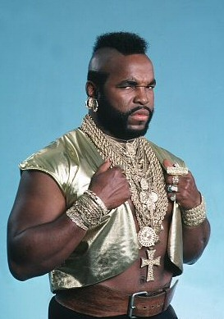
Pr(match) – analysis
Construct the ExtendedDatabase of size n by including the crime stain S (condition on S).
  ExtendedDatabase has α ≈ κn singletons:
  S=S₀, S₁, S₂, S₃, …, S_{α-1}
Innocent suspect arrested, with haplotype T.
We want Pr(match) = Pr(T=S).
  Modeling assumption: No information from type.
  Same as Pr(T=S_{i}) for any i. (Same information/evidence, so same probability)
    Same unrelatedness to innocent suspect.
Obtain in 3 steps.

Slide 11
Pr(match) – 3 part calculation
Assume T is type of innocent suspect
A | T is in ExtendedDatabase | Pr(A)=1−κ
B | T=S_{i} for some singleton S_{i} in the ExtendedDatabase | Pr(B|A)≤κ
C | T=S (=S₀ ) | Pr(C|B&A)=1/nκ
1/n
S
reference sample D of n types
non-singletons
Pr(C) =Pr(C&B&A)
=Pr(C|B&A)·Pr(B|A)·Pr(A) ≤ (1−κ)/n.
singletons

Slide 12
So … Pr(T=S) ≈ (1−κ)/n
Imagine κ=90%. Then Pr(T=S) ≈ 1/10n.
LR = 1/Pr(T=S) ≈ 10n is the odds against a random match, the strength of evidence against a matching suspect.
1/(1−κ) – equal to 10 in this example – is the inflation factor, the factor by which the matching LR exceeds the simple counting rule estimate.

Slide 13
Not so fast! Check assumptions.
Model assumption #1: No information from type.
My derivation that Pr(T=S)≤(1−κ)/n relies on a subtle modeling assumption –
  The singletons in the database over-represent their population proportion by (at least) as much as the non-singletons do.
Checking: extensive population simulations.

Slide 14
Validation of the “κ method”
Valid: LR_{κ} ≈ 1 / E(freq(S) | S is singleton)
(Expectation is taken over all singleton observations.)
3%
population growth/generation
27 simulated model populations span the realistic range of size, growth, mutation rate.
For each sample size n=300, 1000, …, many samples drawn.
All singletons’ pop’n freqs were compared with the κ formula.
Looks ok.
κ model relative error
population size,
mutation rate
sample size

Slide 15
(forensic) mathematical exposition
Features / paradigm
Benefits
State problem
Formulate it mathematically
State premises
  What is the model?
Justify the premises
  Validate the model.
    Test=innocent suspect
Derive the result
Communicate
Explain accurately
Logical; persuasive
  Linear deductive organization
Facilitate discussion/argument
  Where do we disagree?
    Premises? Reasoning step?
  Resolution
Notes:
The linear deductive organization justifies the claims or recommended method.

Slide 16
Rare haplotype matching probability
Features / paradigm
Brenner paper [FP]
State problem
Formulate it mathematically dummy line
State premises
  What is the model?
Justify the premises
  Validate the model.
    Test=innocent suspect
Derive the result
Evidential value of match?
Pr(innocent suspect matches | crime scene, database)
Type is (mostly) just a name
  “equal over-representation”
Validation by tediously simulating/examining suitable range of populations
LR=n/(1-κ) (for new type)
  n=reference database size+1
  κ=singleton proportion
Notes:
The linear deductive organization justifies the claims or recommended method.

Slide 17
criticisms
[BKW] claim: κ method’s “type=arbitrary name” approach ignores “substantial information” from the repeat lengths.
  My approach can be extended to include whatever information. I merely began with the simplest model.
  “Substantial information” sounds confident. It’s a plausible guess but from my research it is wrong.
  κ method, uniquely, has been shown to be valid.
* [BKW] J.S. Buckleton, M. Krawczak, B.S. Weir, The interpretation of lineage markers in forensic DNA testing, FSI Genetics (2011) 5, 78-83
Notes:
Starting point; walk before you can run. Wrong: see my poster.

Slide 18
“we have shown …” – where?
[BKW]: “as we have shown, Brenner’s approach … suffers from potential anti-conservativeness in the way it inherently estimates haplotype frequencies.”
  (Hey! It’s “matching probability”, not “haplotype frequency”!)
Shown where? Three possible answers
  Dead end attempt at analysis
  Invalid counterexample
  Algebraic blunder
Conclusion: Nothing “shown.”
Notes:
With tacit agreement of the referee

Slide 19
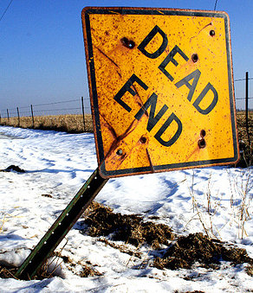
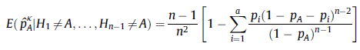
1. Dead-end criticism
[BKW] pursues a hopeful line of analysis, constructing an alternative expression for the value of my formula …
… and get stuck – it “is a complex function ...difficult to judge … if, and to what extent … ”
Too bad the line of analysis didn’t pan out. (Lots of mine don’t either.)
  Why imagine a dead-end is evidence κ method is wrong (or right)?
  Why publish something pointless?
Notes:
I don’t draw conclusion from or publish dead-ends.

Slide 20
2. Invalid counterexample
In [FP] I construct an artificial population Ω^{t} (many exactly equally rare types) where my method would not work.
  Ω^{t} :
Reason – to explain that
  κ method doesn’t claim to be a mathematical identity
  but rather depends on evolutionary mechanisms – on reality,
  hence the example motivates the need for validation.
The validation shows that the method works in reality.
[BKW] cites my example as counterexample to my method!
  Misunderstand 2 & overlooked 3.
  In particular [BKW] says the opposite of 2A.
… (t=1000 types)
☞
☞
Notes:
“my example” – and noted it as mine. Hence they write as if my paper includes it’s own disproof! Shouldn’t that thought ring an alarm, suggest re-reading more carefully?

Slide 21
3. Criticism by mistake
Notation: Sample of n haplotypes. p=probability particular type=A
Easy algebra:
  Pr(particular type ≠ A) = 1-p
  Pr( 0 = # observations of A in sample) = (1-p)^{n}
  Pr( 0 < # observations of A in sample) =1-(1-p)^{n}
[BKW]: Pr( 1 < # observations of A in sample) =1-(1-p)^{n}
  If true that would (in the context) imply that the κ method has a counter-intuitive consequence.
    Pointless (since counter-intuitive ≠ wrong) if so.
  But since 1≠0, it’s not even true.
1= 0 !
Notes:
3 co-authors & referee don’t care. This is not a paper about mathematics, just untutored opinions. If they don’t take their paper seriously – and they didn’t; it’s just a pastiche with no concern about consistency or collaboration – we should not either.

Slide 22
Assessment of validity
Result: LR_{κ}=n/(1-κ) is a reasonable assessment of the evidence that a matching haplotype suspect is the donor when the crime scene haplotype is unseen in a database.
The paper [FP] derives and validates the formula in a coherent, linear deductive presentation, the appropriate framework for discussion including criticism.
  Known criticisms make no sense.
  Better to assess the logic of the paper & see if and exactly where there is a flaw or disagreement.

Slide 23
Final comments
LR = 1/Pr(T=S)
κ method: LR ≈ n/(1−κ) for a new type.
  Test is the innocent suspect, e.g.
    probability that an random suspect would match the crime scene type
  (Matching) probability is not (haplotype) frequency
    (inference from data; no confidence intervals)
  Condition on the crime scene type
    (toss into database. No more “0 count”.)
  Sample frequency may not approximate probability
    LR can be >> sample size

Slide 24
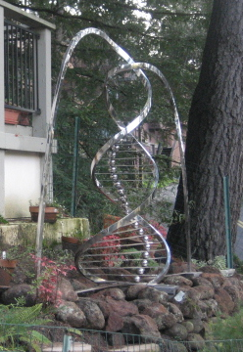
The end
The rules of genetics are simple. Their consequences are not always obvious.

Slide 25
Understanding Y haplotypes
  Evolutionary history and population genetics
  Evidential value

Slide 26
All men are related
All men alive today have a common Y-chromosome ancestor
(probably 3,000 generations ago)

Slide 27
Identity by descent or by state?
Two men have the same Yfiler haplotype.
Connected to a common ancestor without mutation (IBD), or not?
(Terminology:
  IBD = Identity by descent = related with no intervening mutations
  IBS = Identity by state = same haplotype maybe coincidentally)

Slide 28

Y-haplotype lineage
mutation
“Adam”
Convergent mutation (rare)
“Time’s winged chariot”
Same color = same Y-haplotype

Slide 29
Convergent Y mutation
Y haplotype = 17 numbers = position in 17-space
Mutation is random walk in 17 dimensions
  Each step is +1 or -1 in some dimension.
  2 × 17 =34
Random walks rarely return to start.
  2 mutation separation: 1/34 chance that 2nd mutation reverses 1st one.
  Probability to converge otherwise is negligible.
Identical Y-filer haplotype => relationship to common ancestor without mutations (IBD)

Slide 30
Convergence experiment
Simulated Y-filer population (N=90000)
Small proportion of pair-wise matches
  Pr(match)= 1/9000
Given match (IBS), are all IBD?
  Pr(IBD | IBS) = 33/34 (experimental, from simulation)
  Close to computed estimate of non-convergence (previous slide).
    (Why? They are not the same experiment.)

Slide 31
Time to diverge
μ ≈ 1/350 per locus per generation (1/150-1/3000)
μ ≈ 5% per generation (17 loci)
Suppose 4 generations / century
  Common ancestor century ago = 3rd cousins
  8 meioses per century of separation between two contemporary men
Pr( Y’s equal after 1 century) = 70%
Expected # differences = 4/millenium.

Slide 32
Y-haplotype divergence
32
16
8
Expected # differences
4
2
1
virtual non overlap of races

Slide 33
Comments on crime-suspect match
If suspect not donor, then
    97% that suspect and donor are IBD
    which is very unlikely if they are separated by more than a few centuries.
A 17-locus haplotype is typically represented by a small number* of men descended without mutation from a common ancestor 300 years ago.
Probably way beyond immediate family.
* 1/10000 of the population

Slide 34
probability two random men match?
Example: 1272 Caucasian men (ABI)
  808000 pairwise comparisons (big sample!)
    90% of 1272 men are singletons (no pairwise matches)
    49 pairs of matching haplotypes (49 matches)
    5 triples (5×3=15 pairwise matches)
  … in total 91 pairwise matches / 808000
  Pairwise matching rate 1/8900
Can evidential strength (new type) be less than that? (no matter what the “upper confidence” limit may be)

Slide 35
Probability of a new Y haplotype
Assume Y-filer (17 STR loci)
Probability in an actual database?
  Example: 1272 Caucasian men (ABI sample)
    90% are “singletons”
Smaller database
  If n=1, 100% singletons
Suppose we collect the entire world male population. What % of singletons?

